Slide 1
Heart of Darkness
K. Shipp
Centennial High School

Slide 2
“My task which I am trying to achieve is, by the power of the written word, to make you hear, to make you feel – it is, before all, to make you see.
–Joseph Conrad

Slide 3
Joseph Conrad Biography
Born Jozef Teodor Konrad Nalecz Korzeniowski in 1857 in Russian-controlled Poland
By the age of twelve, he lost both parents to tuberculosis
Served as both a French and British merchant marine
Heart of Darkness was published in 1898

Slide 4
Joseph Conrad Biography
His numerous voyages took him everywhere – from the West Indies to India and Singapore to the Belgian Congo in 1890
A romantic for whom sailing was an emotional and spiritual vocation
Heart of Darkness is a result of these experiences and Conrad’s writing of them in a journal

Slide 5
Conrad’s Art
Conrad’s fiction is characterized by a narrative technique that involves time shifts, stories within stories, and the use of symbol and myth.
“The artist appeals to that part of our being which is not dependent on Wisdom. . . . He speaks to our capacity for delight and wonder, to that sense of mystery surrounding our lives; to our sense of pity, and beauty, and pain.” – Joseph Conrad

Slide 6
Background
Like many authors, Joseph Conrad drew on his experiences when he wrote. He often incorporated details about people he had known, places he had visited, and events he had witnessed.
This technique gives Heart of Darkness a sense of authenticity and immediacy.

Slide 7
Background
Novella based on a four-month stint Conrad spent in the Congo.
Eager for a chance to realize his boyhood dream of exploring central Africa, he accepted an assignment to command a steamboat up the Congo River
Belgian Company for Upper-Congo Commerce was ranked as one of late-nineteenth-century Europe’s most successful—and greedy—traders in ivory.

Slide 8
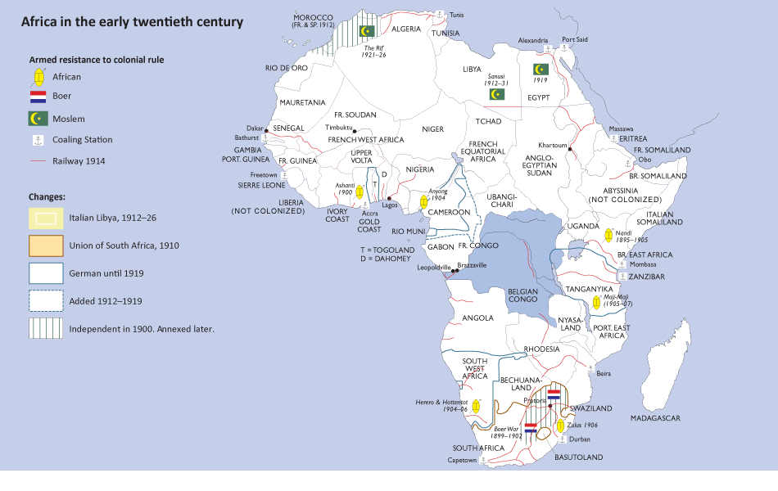

Slide 9
The Congo River
The Congo extends some 1,600 miles into Africa from its eastern coast to its western edge, where the river empties into the Atlantic Ocean, and that only one stretch of it is impassable.
That section lies between Matadi, two hundred miles in from the mouth of the Congo, and Kinshasa, yet another two hundred miles further inland.

Slide 11
Roi des Belges, Riverboat used by Conrad in 1890 to travel up the Congo River

Slide 12
The Congo River
In HOD, Marlow, our narrator, travels up the Congo River in search of a man named Kurtz.
Conrad calls Matadi the Company Station and Kinshasa the Central Station. Between those two places, one is forced to proceed by land, which is exactly what Marlow does on his "two hundred-mile tramp" between the two Stations, described in the book.
The Inner Station is connected to Kurtz, the man Marlow seeks throughout the text.

Slide 13
Joseph Conrad Biography
Conrad offered the position of captain of a river steamer in the Congo in 1890
The previous captain had been butchered by native Africans
Conrad’s four month journey left him near death with dysentery and fever; his health was affected for the rest of his life
Similar to writers who were products of war, Conrad felt his experiences in the Congo transformed him
“…before the Congo, I was just an animal”

Slide 14
Time & Place
The novella takes place in the Congo River basin in the summer of 1890, during a period when the colonization of Africa was at its peak and Belgium’s King Leopold II was ruthlessly exploiting the land and its people.
European countries rushed to claim territory in Africa and to establish strongholds that would secure their status as world powers.
Before that period, few Europeans had explored the “Dark Continent.”

Slide 15
Significance of Title
Heart of Darkness by Joseph Conrad
Africa considered the “Dark Continent”
Conrad’s take on this mindset in the title of his work
“On Being Brought From Africa to America” by Phillis Wheatley
‘Twas mercy brought me from my Pagan land,
Taught my benighted soul to understand
That there's a God, that there's a Saviour too:
Once I redemption neither sought nor knew.
Some view our sable race with scornful eye,
"Their colour is a diabolic die."
Remember, Christians, Negros, black as Cain,
May be refin'd and join th’ angelic train.

Slide 16
Interpret Wheatley’s last line.
“On Being Brought From Africa to America”
‘Twas mercy brought me from my Pagan land,
Taught my benighted soul to understand
That there's a God, that there's a Saviour too:
Once I redemption neither sought nor knew.
Some view our sable race with scornful eye,
"Their colour is a diabolic die."
Remember, Christians, Negros, black as Cain,
May be refin'd and join th’ angelic train.

Slide 17
Three Views of Africa
Savages need to be saved (the White Man’s Burden).
Africa represents the economic prospects of free slave labor and ivory.
Africa represents the opportunity for adventure and self-exploration.

Slide 18
The White Man’s Burden
A prevalent feeling among Europeans of the 1890s was that the African peoples required introduction to European culture and technology in order to become more evolved.
The responsibility for that introduction, known as the "white man's burden," gave rise to a fervor to bring Christianity and commerce to Africa.
What the Europeans took out of Africa in return were huge quantities of ivory.

Slide 19
Symbols, Motifs, Themes in HOD
Light vs. Dark
Women
Civilization vs. Savagery
Outer vs. Inner
Fog
Death
River
The jungle
Ivory
Colors

Slide 20
The Fates (Moirai)
Clotho: spinner of the thread of life
Things that are
Lachesis: measurer of the thread of life
Things that were
Atropos: cutter of the thread of life (death)
Things that are to be

Slide 21
Heart of Darkness
The expectation by Monday, 10/28 is:
You will have completed reading Heart of Darkness.
You will have taken notes on your assigned symbol, theme, or motif. This can be done in multiple forms:
Post-It Notes
Annotations on the page (if paperback)
Log/Chart of annotations on a separate sheet
You will bring your book and your symbol/theme/motif notes with you to class.

Slide 22
King Leopold II
Leopold II described his motives to the rest of Europe as springing from a desire to end slavery in the Congo and civilize the natives, but his actual desires were for material gain.
In Heart of Darkness, Conrad refers to the International Society for the Suppression of Savage Customs.
Leopold II, who was to be sole ruler of this land, never set foot in the Congo Free State. Instead, he formed a company, called simply the Company in Heart of Darkness, which ran the country for him.

Slide 23
The White Man’s Burden
God has not been preparing the English speaking and Teutonic peoples for a thousand years for nothing but vain and idle self-contemplation and self-admiration. No! He has made us adept in government that we may administer government among savage and servile peoples.
Albert Beveridge (1903)

Slide 24
Social Darwinism
a belief, popular in the late Victorian era in England, America, and elsewhere, which states that the strongest or fittest should survive and flourish in society, while the weak and unfit should be allowed to die.
Promoted by Herbert Spencer, whose ethical philosophies always held an elitist view and received a boost from the application of Darwinian ideas such as adaptation and natural selection.

Slide 25
Social Darwinism
Herbert Spencer, the father of Social Darwinism as an ethical theory, was thinking in terms of elitist, "might makes right" sorts of views long before Darwin published his theory. However, Spencer quickly adapted Darwinian ideas to his own ethical theories.
Not only was survival of the fittest natural, but it was also morally correct. Indeed, some extreme Social Darwinists argued that it was morally incorrect to assist those weaker than oneself, since that would be promoting the survival and possible reproduction of someone who was fundamentally unfit.

Slide 26
A Psychological Text
The stream of consciousness and internal monologue emphasized a shift in focus from the external world to the interior world.
Dreams, thoughts, and explanations of a character’s mental process replaced lengthy descriptions of external objects.
Conrad focuses on the internal world of his characters, and the reality of their dreams and thoughts. Marlow’s story suggests a nightmarish journey into the unknown.

Slide 27
Literary Impressionism – 1867-1886
Working in small groups, define the concept by examining Impressionist paintings and describing elements common to at least three of the paintings.

Slide 28
Impressionism
Define it by using the following painting by Monet as its primary example.

Slide 29
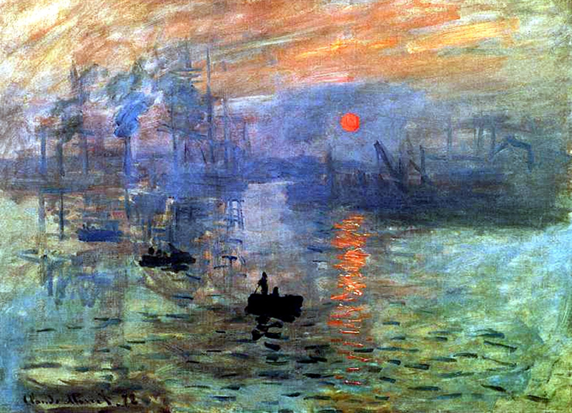
Claude Monet’s Impression: Sunrise

Slide 30
Literary Impressionism
Now apply your understanding of “impressionism” to literature.
How would the elements of “impressionism” apply to the written word?

Slide 31
Summary of Impressionism

Slide 32
Literary Impressionism
“A highly personal manner of writing in which the author presents materials as they appear to an individual temperament at a precise moment and from a particular vantage point rather than as they are presumed to be in actuality.”
Writers borrowed the term from painters who revolted against conventional beliefs about art and who believe that “it was more important to retain the impressions that an object makes on the artist than to present the appearance of that object by precise detail and careful, realistic finish.”
Harmon, William, and C. Hugh Holman. “Impressionism.” A Handbook to Literature. 8th ed. Upper Saddle River, NJ: Prentice Hall, 2000. 266.

Slide 33
Literary Impressionists…
Use a narrative style that is intentionally ambiguous, placing more responsibility on the reader to form his or her own conclusions about events within the novel, rather than relying on the narrator.
Often describe the action through the eyes of the character while the events are occurring, rather than providing details after the character has already processed the action. The result is sometimes like being in an accident – where everything appears to be moving in slow motion. All of the details seem unclear.
Are concerned with the “emotional landscape” of the setting. They’re interested in the ways the setting evokes certain emotional responses from both the characters and the reader.

Slide 34
Literary Impressionists…
Employ details in such a way that it’s sometimes difficult to see a clear picture of events if you focus on the details too closely. Much like an impressionistic painting, it’s only possible to get a full picture once you stand back from the novel and view it in its entirety.
Often avoid a chronological telling of events. Instead, they give the reader information in a way that forces them to focus on how and why things happen, rather than on the order in which they occur.

Slide 35
Example from Part II of HOD
“I saw a face amongst the leaves on the level with my own, looking at me very fierce and steady; and then suddenly, as though a veil had been removed from my eyes, I made out, deep in the tangled gloom, naked breasts, arms, legs, glaring eyes – the bush was swarming with human limbs in movement, glistening, of bronze colour. The twigs shook, swayed, and rustled, the arrows flew out of them, and then the shutter came to.”

Slide 36
Example from Part II of HOD
Notice how Conrad’s narrator reports things as they’re happening, before he’s had a chance to process the information. Notice also the attention to color and movement. It’s interesting to note that at this point, the speaker is actually under attack. Yet it takes him a few more lines before he realizes this, further enhancing the sense that the reader is experiencing the attack with the narrator.

Slide 37
Impressionism in Music
http://youtu.be/X1e7gz-l5kY
"There is no theory. You have merely to listen. Pleasure is the law.” – Claude Debussy

Slide 38
Literary Impressionism
Example #1 from Part II:
p. 92 (“As to me, I seemed to see Kurtz for the first time…”)
Example #2 from Part II:
p. 93 (“I saw him extend his short flipper of an arm…”)
Example #3 from Part II:
p. 103 (“I don’t know how it struck the others…”)

Slide 39
Ian Watt on Heart of Darkness
Find two statements by Ian Watt that highlight an understanding about Heart of Darkness that was new and/or interesting to you. Mark these statements and their location/page numbers.
Be prepared to share and discuss your choice.

Slide 40
Symbols, Motifs, Themes in HOD
Light vs. Dark
Women
Civilization vs. Savagery
Outer vs. Inner
Fog
Death
River
The jungle
Ivory
Colors

Slide 41
Symbolism in HOD
Find 2-3 examples of your symbol in the text.
Discuss how your symbol functions in the work. How is it developed and what does it do?
Discuss what your symbol reveals about characters/themes in the work as a whole. Think about how your symbol contributes to the “impression” Conrad is constructing.

